Slide 1

Hexagonal* Architecture** *** * or ports and adapters ** or design pattern *** or maintainable code

Slide 2










Randy Vroegop
Software Engineer

Slide 3
Writing simple code is hard.
Notes:
For simple code there is a hard requirement of either: * No previous code, clean workslate
* Understanding of the previous code (hard to do)

Slide 4
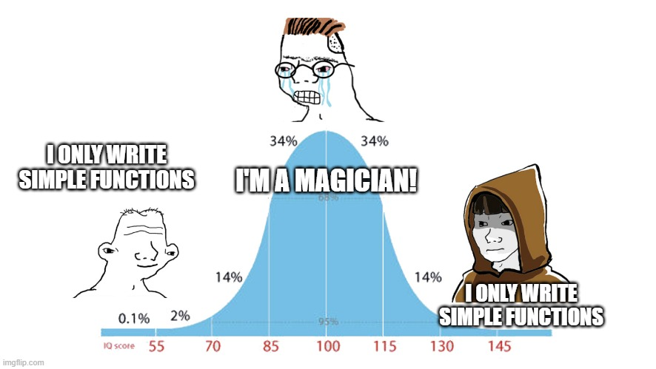
Notes:
For simple code there is a hard requirement of either: * No previous code, clean workslate
* Understanding of the previous code (hard to do)

Slide 5
boolean canShip(Order o) { return o != null && o.isPaid() && !o.isCancelled() && o.getItems() != null && !o.getItems().isEmpty() && o.getAddress() != null && o.getAddress().isValid(); }
Notes:
To understand this code, you have to really read

Slide 6
boolean canShip(Order o) { return o != null && o.isPaid() && !o.isCancelled() && o.getItems() != null && !o.getItems().isEmpty() && o.getAddress() != null && o.getAddress().isValid(); }
boolean canShip(Order o) { return hasPayment(o) && hasItems(o) && hasValidAddress(o); } boolean hasPayment(Order o) { return o != null && o.isPaid() && !o.isCancelled(); } boolean hasItems(Order o) { return o.getItems() != null && !o.getItems().isEmpty(); } boolean hasValidAddress(Order o) { return o.getAddress() != null && o.getAddress().isValid(); }
Notes:
To understand the code on the right you have to read less. To see if there is a bug, only 25% of the code needs to be read.

Slide 7

SOLID
Notes:
For hexagonal architecture to work, we have to go over these concepts.
First question: does everyone understand dependency injection? If not, explain on slide 17 where we introduce Dependency Inversion with an interface. They look anstract, and some will remain abstract as the understandig of SOLID is not a goal, but let’s go over them anyway. Some of these principles might make it easier to see what Hexagonal is all about.

Slide 8
Single responsibility
❌ Bad class Report { void generate() {} void saveToFile() {} }
✅ Good class Report { void generate() {} } class FileSaver { void save(String data) {} }

Slide 9
Open / Closed
interface Discount { double apply(double price); } class VipDiscount implements Discount { public double apply(double p) { return p * 0.9; } } class StudentDiscount implements Discount { public double apply(double p) { return p * 0.8; } }
class DiscountCalculator { double calc(String type, double price) { if (type.equals("VIP")) return price * 0.9; if (type.equals("STUDENT")) return price * 0.8; return price; } }
Notes:
Open Closed is about relying on abstract concepts which you can implement infinite number of times. This only works if you really know how Open Closed works, and if the code was set up that way. If so, it is extremely powerful. This allows you to add functionality knowing for sure you won’t introduce bugs (unless code further down the line has side-effects). This is (or should be!) easily unit-testable.

Slide 10
Liskov Substitution Principle
interface Storage { void save(String data); } class FileStorage implements Storage { public void save(String data) { System.out.println("Saving to disk: " + data); } } class ReadOnlyStorage implements Storage { public void save(String data) { throw new UnsupportedOperationException("Storage is read-only"); } }
class FileStorage { void save(String data) { System.out.println("Saving to disk: " + data); } } class ReadOnlyFileStorage extends FileStorage { @Override void save(String data) { System.out.println("Read-only mode — data NOT saved!"); } }
Notes:
This might be a nobrainer, but if you extend something you should always fully and completely provide all functionality of the parent.

Slide 11
Interface Segregation principle
interface Workable { void work(); } interface Eatable { void eat(); } class Robot implements Workable {
public void work() {}
} class Human implements Workable, Eatable { public void work() {} public void eat() {} }
interface Worker { void work(); void eat(); } class Robot implements Worker { public void work() {} public void eat() {} // robots don’t eat! }
Notes:
Splitting things up into several interfaces makes it way easier to refactor your code and to have less distractions while coding. One class implementing many interfaces is not in any way worse than one big interface.

Slide 12
The D is for…

Slide 13
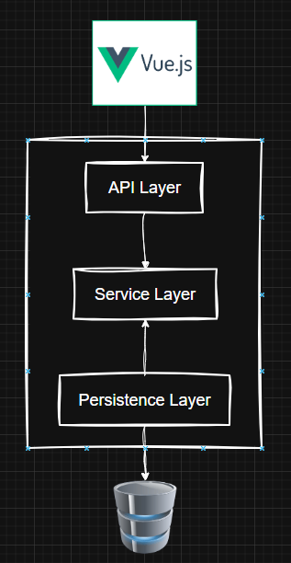
Notes:
Dependency Inversion! But really…

Slide 14
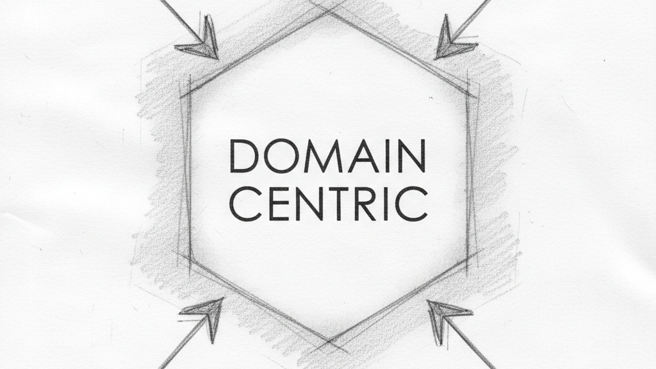
Notes:
Lets go over how this works.

Slide 15
Dependency Inversion
save(data)
API
Domain
Persistence
Notes:
Lets start from a layered architecture. The flow of data is easy to follow, left to right.
Lets now invert the dependency. Now you can no longer save your data from the domain perspective.

Slide 16
Dependency Inversion
save(data)??
API
Domain
Persistence
Notes:
Lets now invert the dependency. Now you can no longer save your data from the domain perspective.

Slide 17
Dependency Inversion
API
Domain
save(data)
Persistence Interface
Persistence
Notes:
To fix this, we need to add an interface.
Now we can save the data through the interface. Persistence now has to implement the interface. (THIS REQUIRES DEPENDENCY INJECTION!)
We can now rename our interface and persistence classes to be named Ports and Adapters!

Slide 18
Dependency Inversion
API
Domain
save(data)
Persistence
Port
Persistence
Adapter
Notes:
We can now rename our interface and persistence classes to be named Ports and Adapters!
We can add ports and adapters on all sides.

Slide 19
Domain Centric
Domain
API Adapter
API Port
Domain
Persistence
Port
Persistence
Adapter
Notes:
We can add ports and adapters on all sides.
Now we are domain centric!

Slide 20
Ports and Adapters AKA Hexagonal Architecture
Domain
API Adapter
API Port
Domain
Persistence
Port
Persistence
Adapter
Notes:
Now we are domain centric!
This means a lot more classes and interfaces need to be maintained.

Slide 21
More things to be maintained!
Notes:
Hexagonal introduces more classes and interfaces, and even models if you didn’t use extra models for transportation or storage already.

Slide 22

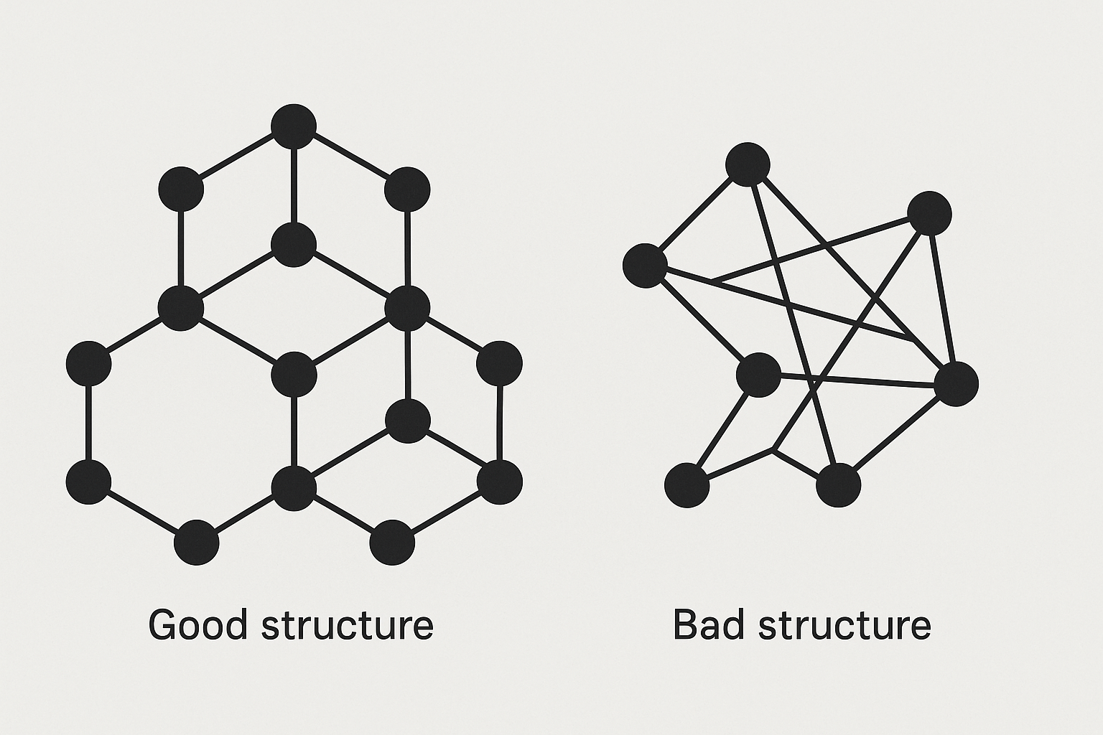
Hexagonal architecture may introduce more classes, interfaces, and models.
It trades structural simplicity for conceptual clarity.

Slide 23

Layered architecture
Hexagonal architecture
Presentation
Presentation
Adapter / Infrastructure
Business Logic
Business Logic
Business Logic
Persistence
Persistence
Adapter / Infrastructure
Notes:
The difference is remarkably simple: Inverse your dependencies - everything relies on domain Making your Business Logic define interfaces for your Adapters, which are where your ‘outside world code’ lives, you automatically think about your interfaces from a domain perspective.

Slide 24
github.com
Notes:
Before we dive in, let me show you the current code setup.

Slide 25
api
service
persistence
UserEntity username email fullName
UserController GET /api/users GET /api/users/{id} POST /api/users PUT /api/users/{id}
UserService ListUsers() getUser(id) createUser(userData) updateUser(id, userData)
< JPA< UserEntity > > UserRepository existsByUsername(name)
Notes:
Here is the working, layered architecture.

Slide 26
github.com/vroegop/hexagonal
api
domain
h2database
UserEntityDTO username email fullName
UserEntity username email fullName
UserEntityDAO username email fullName
Maps from
Maps to
<< INTERFACE >> UserReader ListUsers() getUser(id)
UserController GET /api/users GET /api/users/{id} POST /api/users PUT /api/users/{id}
UserService ListUsers() getUser(id) createUser(userData) updateUser(id, userData)
<< INTERFACE >> UserStoragePort save(UserEntity) update(UserEntity)
get(username)
getAll()
UserStorageAdapter save(UserEntity) update(UserEntity)
get(username)
getAll()
<< INTERFACE >> UserWriter ListUsers() getUser(id)
< JPA < UserEntityDAO > > UserRepository existsByUsername(name)
Localhost:8080/index.html
Notes:
Here is the desired architecture. Way more classes, models, interfaces etc. but it is now easier to expand to a enterprise size without introducing tight coupling or other hard refactorable issues.

Slide 27
So, you want to do it even better?
Make your domain a module Only allow Test and JSR330 dependencies for domain – the rest is forbidden
Every “Adapter” has its own module
Turn on Annotation Scanning for JSR330 annotations in Spring Boot (or any other dependency injection framework)
You will need an extra “Application” module to host your dependency injection
The application module depends on all other modules.
Adapters can depend on Domain. Domain depends on not a single adapter
See the branch called “modularized”
Notes:
THIS SLIDE IS NOT FOR THE PRESENTATION BUT AVAILABLE IN THE REPOSITORY FOR CONTEXT.

